Slide 1

Science
N 3-4
Year
4
Curriculum Map and Assessment
Framework
Year
1
Year
5
Key Stage 3

Slide 2
EYFS – Understanding the World
N 3-4
Year
4
Development Matters
Nursery
Development Matters Reception
ELG
Past and Present
Use all of their senses in hands-on exploration of natural materials.
Explore collections of materials with similar and/or different properties.
Plant seeds and care for growing plants.
Explore and talk about different forces they can feel.
Understand the key features of a life cycle of a plant and an animal.
Talk about the differences between materials and changes they notice.
Begin to understand the need to respect and care for the natural environment and all living things.
Explore the natural world around them.
Describe what they see, feel and hear whilst outside.
Understand the effect of changing seasons on the natural world around them.
Recognise some environments that are different to the one in which they live.
Children at the expected level of development will:-
Understand some important processes and changes in the natural world around them, including the seasons and changing states of matter.
Explore the natural world around them, making observations and drawing pictures of animals and plants.
Year
1
Year
5
Key Stage 3

Slide 3

EYFS – Milestones for Continuous Provision
N 3-4
Year
4
Children in Nursery will:
Children in Reception will:
Year 1 Ready:
Use their senses in hands on exploration.
Sort clothing to wear in different climates /weather.
Match animals to their young.
Plant seeds and look after growing plants with support.
Identify that certain animals live in different environments.
Identify some key signs of each season.
Talk about what plants need to survive.
Care for the natural world and living things.
Sequence the life cycles of living things.
Talk about changes they observe e.g. melting, freezing, cooking.
I can recognise that I have changed since I was a baby and discuss some of those changes
I can talk about what I did yesterday/last week
I can order events in my day
I can talk about things that happened a long time ago, a short time ago and today
I can talk about why we remember special historical events
I can talk about people who help us
Year
1
Year
5
Science - The Natural World
Key Stage 3

Slide 4
EYFS – Milestones for Continuous Provision
N 3-4
Year
4
Children in Nursery will:
Children in Reception will:
Year 1 Ready:
Explore and talk about different forces they can feel.
Sort collections of materials with similar/ different properties.
Begin to use vocabulary such as hard, soft, rough, smooth, light and heavy.
Talk about changes they observe e.g. melting, freezing, cooking.
Describe what they see, hear and feel when exploring forces and materials.
I can name the parts of a plant – roots, stems, leaves, bulb, flower.
I can identify what a plant needs to grow and survive – water and light.
I can name the four seasons – Autumn, Winter, Spring, Summer.
I can discuss why water freezes and know it is called ice.
I can discuss why ice melts and know it turns to water.
I can use the term floating and sinking accurately.
I can name different animals from hot and cold locations and discuss their habitats.
I can describe the life cycle of a butterfly.
Year
1
Year
5
Science – Forces and Materials
Key Stage 3

Slide 5
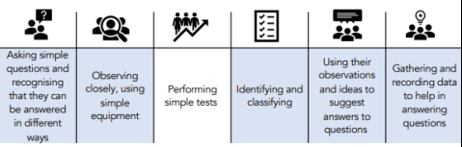
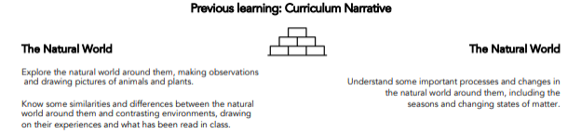
Key Stage 1 – Year 1
Term | NC objectives | The Big Idea Substantive Concepts | How will I think and act like a Scientist | Pupil Outcomes Scientific knowledge and understanding
Year 1 Autumn Term | observe changes across the 4 seasons observe and describe weather associated with the seasons and how day length varies | Seasons and weather Day and night What happens when the seasons change? |  | I can identify how the leaves change colour and fall from the trees in autumn, that it gets cooler and can be warm or wet and windy. I can identify that in winter, it is cold and there is less sunlight so it gets dark sooner. I can identify that in summer, it is hotter, the trees have lots of leaves and there is more daylight. I know that Earth spins once a day; when the sun shines on you, it is day, but when the sun has set it is night time so it gets dark; the sun does not move.
Curriculum Narrative and Previous Learning
N 3-4
Year
4
Year
1
Year
5
Key Stage 3

Slide 6
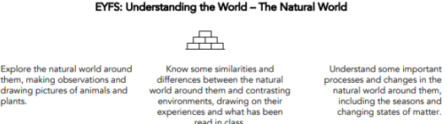
Key Stage 1 – Year 1
Term | NC objectives | The Big Idea Substantive Concepts | How will I think and act like a Scientist | Pupil Outcomes Scientific knowledge and understanding
Year 1 Autumn Term | identify and name a variety of common wild and garden plants, including deciduous and evergreen trees identify and describe the basic structure of a variety of common flowering plants, including trees. | Plants, including trees What makes a tree? |  | I know that trees are made up of leaves, twigs, branches, a trunk, roots and the crown (branches, twigs and leaves); tree bark protects the tree; branches grow from the trunk. I can identify trees by their leaves. e.g. oak, beech, horse chestnut and scots pine. I know that deciduous means they lose their leaves annually in Autumn but regrow them in spring and evergreen means they keep their leaves and stay green all year round.
Curriculum Narrative and Previous Learning
N 3-4
Year
4
Year
1
Year
5
Key Stage 3

Slide 7
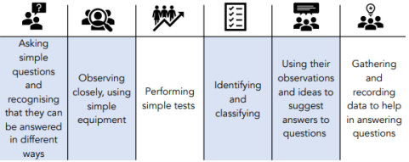
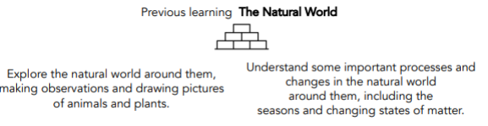
Key Stage 1 – Year 1
Term | NC objectives | The Big Idea Substantive Concepts | How will I think and act like a Scientist | Pupil Outcomes Scientific knowledge and understanding
Year 1 Autumn Term | • identify and name a variety of common animals including fish, amphibians, reptiles, birds and mammals • identify and name a variety of common animals that are carnivores, herbivores and omnivores • describe and compare the structure of a variety of common animals (fish, amphibians, reptiles, birds and mammals including pets) • identify, name, draw and label the basic parts of the human body and say which part of the body is associated with each sense | Animals, including humans How do I know if it’s an animal? |  | I know that animals need to move freely, eat other living things for food, drink water and have sunlight. I know that there are five animal groups – mammals, fish, reptiles, birds and amphibians. I know that mammals are warm-blooded, have skin/hair/fur, give birth to live young and breathe air I know that birds are warm-blooded, have feathers, beaks and wings, lay eggs and breathe air I know that amphibians are cold-blooded, have slimy skin, lay soft eggs and breathe underwater as a baby, then the air when an adult I know that reptiles are cold-blooded, have scaly skin, lay eggs with harder shells and breathe air I know that fish are cold-blooded, have fins and scales, lay soft eggs in water and breathe underwater I know that carnivores eat other animals; herbivores eat plants; omnivores eat plants and animals. I know that humans are mammals, so are warm-blooded, have skin and hair, are born alive and breathe air. I know that humans have five senses: sight, hearing, smell, taste and touch.
Curriculum Narrative and Previous Learning
N 3-4
Year
4
Year
1
Year
5
Key Stage 3

Slide 8
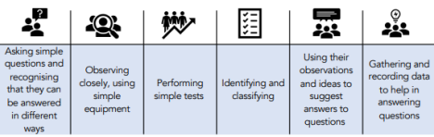
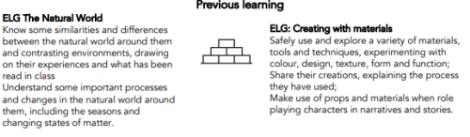
Key Stage 1 – Year 1
Term | NC objectives | The Big Idea Substantive Concepts | How will I think and act like a Scientist | Pupil Outcomes Scientific knowledge and understanding
Year 1 Spring Term | distinguish between an object and the material from which it is made identify and name a variety of everyday materials, including wood, plastic, glass, metal, water, and rock describe the simple physical properties of a variety of everyday materials compare and group together a variety of everyday materials on the basis of their simple physical properties | Everyday materials How can I describe this material? |  | there are different materials including cotton, wool, wood, clay, glass, plastic, water, rock. objects are made from a range of different materials. • properties of materials can be described as smooth, rough, shiny, hard, soft, stretchy, bendy, opaque etc. some materials are man-made and others aren’t. waterproof means that water does not travel through: it is repelled. transparent materials can be seen though; opaque ones are not see through. some materials are suited to particular jobs because of their properties e.g. wood for a table as it is strong.
Curriculum Narrative and Previous Learning
N 3-4
Year
4
Year
1
Year
5
Key Stage 3

Slide 9
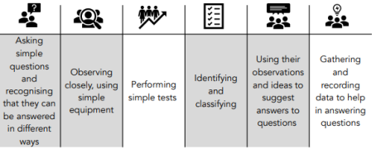
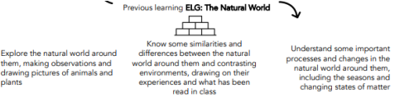
Key Stage 1 – Year 1
Term | NC objectives | The Big Idea Substantive Concepts | How will I think and act like a Scientist | Pupil Outcomes Scientific knowledge and understanding
Year 1 Spring Term | identify and name a variety of common animals including fish, amphibians, reptiles, birds and mammals identify and name a variety of common animals that are carnivores, herbivores and omnivores describe and compare the structure of a variety of common animals (fish, amphibians, reptiles, birds and mammals including pets) identify, name, draw and label the basic parts of the human body and say which part of the body is associated with each sense | REVISIT Animals, including humans How do I know if it is an animal? |  | I know that animals need to move freely, eat other living things for food, drink water and have sunlight. I know there are five animal groups – mammals, fish, reptiles, birds and amphibians. I know that mammals are warm-blooded, have skin/hair/fur, give birth to live young and breathe air (humans, cats, dogs etc.) I know that birds are warm-blooded, have feathers, beaks and wings, lay eggs and breathe air (robins, sparrows, ducks etc.) I know that amphibians are cold-blooded, have slimy skin, lay soft eggs and breathe underwater as a baby, then the air when an adult (frogs, toads etc.) I know that reptiles are cold-blooded, have scaly skin, lay eggs with harder shells and breathe air (snakes, lizards etc.) I know that fish are cold-blooded, have fins and scales, lay soft eggs in water and breathe underwater (salmon, cod etc.) I know that carnivores eat other animals; herbivores eat plants; omnivores eat plants and animals. I know that humans are mammals, so are warm-blooded, have skin and hair, are born alive and breathe air. I know that humans have five senses: sight, hearing, smell, taste and touch.
Curriculum Narrative and Previous Learning
N 3-4
Year
4
Year
1
Year
5
Key Stage 3

Slide 10
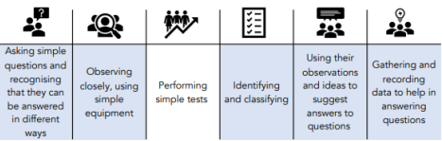
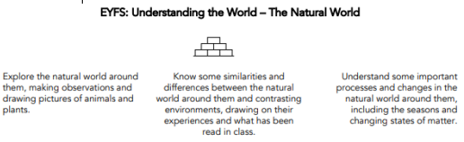
Key Stage 1 – Year 1
Term | NC objectives | The Big Idea Substantive Concepts | How will I think and act like a Scientist | Pupil Outcomes Historical knowledge and understanding
Year 1 Summer Term | identify and name a variety of common wild and garden plants identify and describe the basic structure of a variety of common flowering plants. | Plants and Animals, including humans What makes a plant? |  | I know that plants are made up of a stem, flower, leaves, roots, seeds, leaves and buds. • plants have similarities and differences between them e.g. - shape, size, colour and smell. I know that plants need food, water and light to survive. • wild plants grow naturally without any human help; some common examples are buttercups, stinging nettles, dandelions, daisies and ivy. I know that some plants are helped to grow and need care to survive: sunflowers, tulips, grass, pansies, roses, lavender etc.
Curriculum Narrative and Previous Learning
N 3-4
Year
4
Year
1
Year
5
Key Stage 3

Slide 11
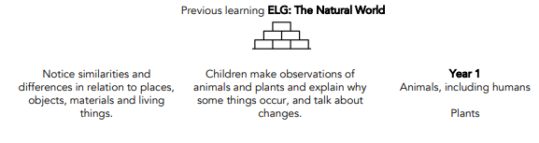
Key Stage 1 – Year 1
Term | NC objectives | The Big Idea Substantive Concepts | How will I think and act like a Scientist | Pupil Outcomes Scientific knowledge and understanding
Year 1 Summer Term | identify and name a variety of common animals including fish, amphibians, reptiles, birds and mammals identify and name a variety of common animals that are carnivores, herbivores and omnivores describe and compare the structure of a variety of common animals (fish, amphibians, reptiles, birds and mammals, including pets) identify and name a variety of common wild and garden plants, including deciduous and evergreen trees identify and describe the basic structure of a variety of common flowering plants, including trees. | Plants and Animals, including humans How do plants and animals change during the year? |  | I know that there are five animal groups – mammals, fish, reptiles, birds and amphibians. I know that mammals are warm-blooded, have skin/hair/fur, give birth to live young and breathe air I know that birds are warm-blooded, have feathers, beaks and wings, lay eggs and breathe air I know that amphibians are cold-blooded, have slimy skin, lay soft eggs and breathe underwater as a baby, then the air when an adult (frogs, toads etc.) I know that reptiles are cold-blooded, have scaly skin, lay eggs with harder shells and breathe air I know that fish are cold-blooded, have fins and scales, lay soft eggs in water and breathe underwater I know that carnivores eat other animals; herbivores eat plants; omnivores eat plants and animals. I know that plants are made up of a stem, flower, leaves, roots, seeds, leaves and buds. I know that plants have similarities and differences between them e.g. - shape, size, colour and smell. I know that plants need food, water and light to survive. I know that wild plants grow naturally without any human help; some common examples are buttercups, stinging nettles, dandelions, daisies and ivy. I know that some plants are helped to grow and need care to survive: sunflowers, tulips, grass, pansies etc I know that deciduous means they lose their leaves annually in Autumn but regrow them in spring and evergreen means they keep their leaves and stay green all year round.
Curriculum Narrative and Previous Learning
N 3-4
Year
4
Year
1
Year
5
Key Stage 3

Slide 12
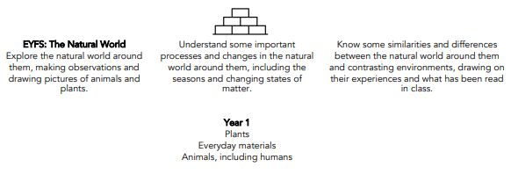
Key Stage 1 – Year 2
Term | NC objectives | The Big Idea Substantive Concepts | How will I think and act like a Scientist | Pupil Outcomes Scientific knowledge and understanding
Year 2 Autumn Term | explore and compare the differences between things that are living, dead, and things that have never been alive identify that most living things live in habitats to which they are suited and describe how different habitats provide for the basic needs of different kinds of animals and plants, and how they depend on each other identify and name a variety of plants and animals in their habitats, including microhabitats describe how animals obtain food from plants and other animals, using idea of a simple food chain | Living Things and their Habitats What do living things need to survive? |  | I know that living things move, grow, consume nutrients and reproduce (MRS GREN); that dead things used to do these things, but no longer do; and that things that never lived have never done these things. I know that to live and grow plants need: sunlight, air and water, and animals need: food, air, water and shelter I know that animals adapt to their environment e.g. polar bear - thick fur for warmth and oily paw pads to ensure that they don’t freeze to the ice.; sharks – smooth skin and streamlined shape for quick swimming; and gills for breathing underwater I know that plants adapt to their environment e.g. cacti - thick skin keeps a store of water safe; sharp spikes keep animals from stealing the water I know that a habitat is a home (place) where animals and plants live e.g. forest, ocean, desert I know that microhabitats are very small habitats, I know that plants make their own food (producers); that the plants are consumed by animals which are herbivores (just plants) and omnivores (plants and meat); and that carnivorous animals (predators) eat other animals (prey).
Curriculum Narrative and Previous Learning
N 3-4
Year
4
Year
1
Year
5
Key Stage 3

Slide 13
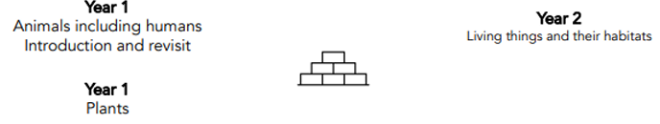
Key Stage 1 – Year 2
Term | NC objectives | The Big Idea Substantive Concepts | How will I think and act like a Scientist | Pupil Outcomes Scientific knowledge and understanding
Year 2 Autumn Term | notice that animals, including humans, have offspring which grow into adults find out about and describe the basic needs of animals, including humans, for survival (water, food and air) describe the importance for humans of exercise, eating the right amounts of different types of food, and hygiene sources of food | Animals including Humans What do animals need to survive and grow? |  | I know that animals with backbones are vertebrates and animals without a backbone are invertebrates. • the acronym MRS GREN stands for Movement, Respiration, Sensitivity, Growth, Reproduction, Excretion and Nutrition I know that animals produce offspring that grow into adults as part of their life cycle I know that exercise keeps us stronger, healthier, strong mind and it will be harder to get sick. I know that insects go through four stages of metamorphosis (change physical form or shape to become an adult) I know that some offspring look the same as the adults and others loo different. I know the six stages in the human life cycle and some features in these stages eg toddler learns to walk and talk I know that animals, including humans, need: food (to provide nutrients), water, warmth and air to survive I know that basic food groups: fruit and vegetables, carbohydrates, protein, dairy, fat and sugary foods and the importance of a balanced diet to keep healthy and to grow. I know that exercise keeps is good for our heart, lungs and muscles. 16 I know that drinking water takes away nasty things inside us and we must replace lost water through sweating and going to the toilet
Curriculum Narrative and Previous Learning
N 3-4
Year
4
Year
1
Year
5
Key Stage 3

Slide 14
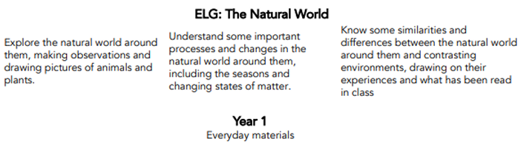
Key Stage 1 – Year 2
Term | NC objectives | The Big Idea Substantive Concepts | How will I think and act like a Historian | Pupil Outcomes Scientific knowledge and understanding
Year 2 Spring Term | identify and compare the suitability of a variety of everyday materials, including wood, metal, plastic, glass, brick, rock, paper and cardboard for particular uses find out how the shapes of solid objects made from some materials can be changed by squashing, bending, twisting and stretching. | Uses of Everyday Materials What is the right material for the job? |  | I know that materials have different properties such as: waterproof; strong; hard; soft; flexible; rigid; light or heavy. I know that the properties of a material decide how useful it is for a given job. I know that applying forces to objects can change their shape. I know that absorbent materials take up liquid. I know that waterproof materials do not let liquid through them.
Curriculum Narrative and Previous Learning
N 3-4
Year
4
Year
1
Year
5
Key Stage 3

Slide 15
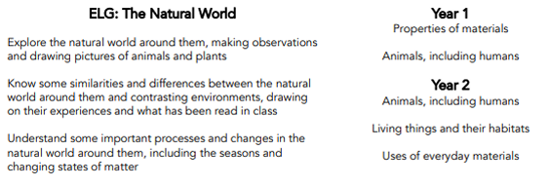
Key Stage 1 – Year 2
Term | NC objectives | The Big Idea Substantive Concepts | How will I think and act like a Historian | Pupil Outcomes Scientific knowledge and understanding
Year 2 Spring Term | explore and compare the differences between things that are living, dead, and things that have never been alive identify that most living things live in habitats to which they are suited and describe how different habitats provide for the basic needs of different kinds of animals and plants, and how they depend on each other identify and name a variety of plants and animals in their habitats, including microhabitats find out how the shapes of solid objects made from some materials can be changed by squashing, bending, twisting and stretching | CHEMISTRY – Uses of Everyday Materials BIOLOGY – Living Things and Their Habitats What is it made from? Compare: What is alive, what is not alive, what has never been alive? |  | I know that many types of plastic are waterproof I know that steel (a type of metal) is strong, that rock is hard; that cotton wool is soft, that rubber is flexible, that rock is rigid, that polystyrene (a type of plastic) is light and that iron (a type of metal) is heavy, I know that some objects are made up from more than on type of material I know that living things move, grow, consume nutrients and reproduce I know that dead things used to do these things, but no longer do; I know that things that never lived have never done these things. I know that materials are chosen to make items because of their specific properties
Curriculum Narrative and Previous Learning
N 3-4
Year
4
Year
1
Year
5
Key Stage 3

Slide 16
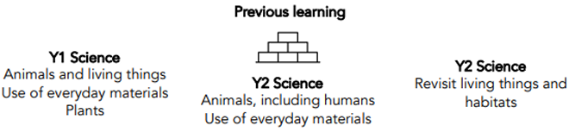
Key Stage 1 – Year 2
Term | NC objectives | The Big Idea Substantive Concepts | How will I think and act like a Scientist | Pupil Outcomes Scientific knowledge and understanding
Year 2 Summer Term | observe and describe how seeds and bulbs grow into mature plants find out and describe how plants need water, light and a suitable temperature to grow and stay healthy. | Plants What do plants need to survive and grow? |  | I know that seeds are living things germination means growth of a seed to a plant I know that a young plant is called a seedling I know that if a plant has drooping leaves and stem it is unhealthy. I know that plants spread their seedling away from the parent plant so that they are not competing for resources I know that a bulb’s roots grown down and the shoot grows up, they mature and die back down to a bulb again. I know that a bulb lays dormant until the next growing season plants grow towards the sunlight and get their energy from the sun I know that seeds and bulbs need to be buried underground in soil and that they will thrive and grow into adult plants under the right conditions (water, warmth, light, air, soil and space) I know that plants that are deprived of water, light, food or air will not grow and will die.
Curriculum Narrative and Previous Learning
N 3-4
Year
4
Year
1
Year
5
Key Stage 3

Slide 17
Key Stage 1 – Year 2
Term | NC objectives | The Big Idea Substantive Concepts | How will I think and act like a Scientist | Pupil Outcomes Scientific knowledge and understanding
Year 2 Summer Term | observe and describe how seeds and bulbs grow into mature plants find out and describe how plants need water, light and a suitable temperature to grow and stay healthy. notice that animals, including humans, have offspring which grow into adults find out about and describe the basic needs of animals, including humans, for survival (water, food and air) describe the importance for humans of exercise, eating the right amounts of different types of food, and hygiene. | Plants How do seeds and bulbs grow? What do I know about animals including humans? |  | I know that seeds are living things I know that germination means growth of a seed to a plant I know that a young plant is called a seedling I know that plants spread their seedling away from the parent plant so that they are not competing for resources I know that a bulb’s roots grown down and the shoot grows up, they mature and die back down to a bulb again. I know that a bulb lays dormant until the next growing season I know that grow towards the sunlight and get their energy from the sun I know that seeds and bulbs need to be buried underground in soil and that they will thrive and grow into adult plants under the right conditions (water, warmth, light, air, soil and space) I know that some offspring look the same as the adults and others loo different. I know that plants that are deprived of water, light, food or air will not grow and will die. I know that the acronym MRS GREN stands for Movement, Respiration, Sensitivity, Growth, Reproduction, Excretion and Nutrition I know that food keeps people healthy, gives people energy and helps people grow
Curriculum Narrative and Previous Learning
N 3-4
Year
4
Year
1
Year
5
Key Stage 3

Slide 18
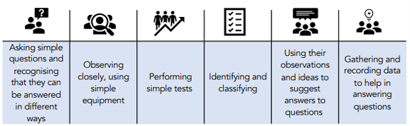

Key Stage 2 – Year 3
Term | NC objectives | The Big Idea Substantive Concepts | How will I think and act like a Scientist | Pupil Outcomes Scientific knowledge and understanding
Year 3 Autumn Term | compare and group together different kinds of rocks based on their appearance and simple physical properties describe in simple terms how fossils are formed when things that have lived are trapped within rock recognise that soils are made from rocks and organic matter | Rocks What makes a rock? |  | I know that there are three kinds of rocks: igneous, sedimentary and metamorphic I know that the Earth has a solid crust made up of tectonic plates with molten rock beneath • granite and basalt are types of igneous rock and that igneous rocks form from molten rock below the Earth’s crust I know that limestone and sandstone are types of sedimentary rock which form when small, weathered fragments of rock or shell settle and stick together, often in layers I know that marble and slate are types of metamorphic rock which form when rocks in Earth’s crust get squashed and heated in processes such as when tectonic plates press against each other I know that fossils form when a plant or animal dies and is quickly covered with silt or mud so that it cannot be rotted by microbes or eaten by scavenging animals; in time layers of sediment build, squashing the mud and turning it to stone around the dead plant or animal; the materials in the body are replaced by minerals that flow in water through the rock, leaving a rock in the shape of the animal or plant that was once there I know that soil is made from tiny particles of rock broken down by the action of weather (weathering)
Curriculum Narrative and Previous Learning
N 3-4
Year
4
Year
1
Year
5
Key Stage 3

Slide 19
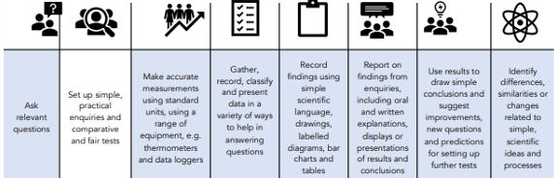
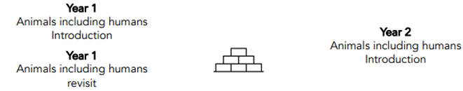
Key Stage 2 – Year 3
Term | NC objectives | The Big Idea Substantive Concepts | How will I think and act like a Scientist | Pupil Outcomes Scientific knowledge and understanding
Year 3 Autumn Term | identify that animals, including humans, need the right types and amount of nutrition, and that they cannot make their own food; they get nutrition from what they eat identify that humans and some other animals have skeletons and muscles for support, protection and movement. | Animals including Humans How does my body move? |  | I know that proteins (meat, fish, eggs and dairy) help us to grow; carbohydrates (bread, cereals, vegetables and sugar) provide us with energy; vitamins, minerals and fibre (fruit and vegetables) keep us healthy; fats can provide energy, help our nerves and brain and absorb vitamins, but we need less of these in our diet; water is essential as our body is mostly made from water. I know that getting the right amount of each food group is called a balanced diet I know that the blood, muscles and organs need water and nutrients to work (our muscles are 79% water). I know that vertebrates are animals with backbones; invertebrates are animals without backbones I know that skeletons support the body; protect the brain and lungs; allow movement through joints; create red blood cells I know that the skull, pelvis, femur, ribcage and humerus are examples of bones in our bodies. I know that muscles can be skeletal (voluntary movement that we control); cardiac muscles (involuntary movement e.g. the heart); smooth muscle (involuntary movements such as the intestines and bladder).
Curriculum Narrative and Previous Learning
N 3-4
Year
4
Year
1
Year
5
Key Stage 3

Slide 20
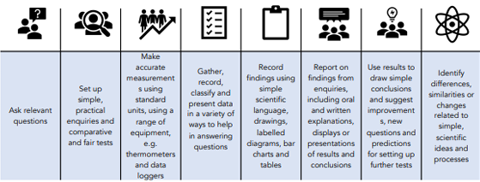

Key Stage 2 – Year 3
Term | NC objectives | The Big Idea Substantive Concepts | How will I think and act like a Scientist | Pupil Outcomes Scientific knowledge and understanding
Year 3 Autumn Term | compare and group together different kinds of rocks on the basis of their appearance and simple physical properties describe in simple terms how fossils are formed when things that have lived are trapped within rock recognise that soils are made from rocks and organic matter | Rocks How are rocks formed and what types are there? How can rocks change? How are fossils formed? |  | I know that there are three kinds of rocks: igneous, sedimentary and metamorphic I know that the Earth has a solid crust made up of tectonic plates with molten rock beneath I know that granite and basalt are types of igneous rock and that igneous rocks form from molten rock below the Earth’s crust I know that limestone and sandstone are types of sedimentary rock which form when small, weathered fragments of rock or shell settle and stick together, often in layers I know that marble and slate are types of metamorphic rock which form when rocks in Earth’s crust get squashed and heated in processes such as when tectonic plates press against each other I know that fossils form when a plant or animal dies and is quickly covered with silt or mud so that it cannot be rotted by microbes or eaten by scavenging animals; in time layers of sediment build, squashing the mud and turning it to stone around the dead plant or animal; the materials in the body are replaced by minerals that flow in water through the rock, leaving a rock in the shape of the animal or plant that was once there I know that soil is made from tiny particles of rock broken down by the action of weather (weathering)
Curriculum Narrative and Previous Learning
N 3-4
Year
4
Year
1
Year
5
Key Stage 3

Slide 21
Key Stage 2 – Year 3
Term | NC objectives | The Big Idea Substantive Concepts | How will I think and act like a Scientist | Pupil Outcomes Scientific knowledge and understanding
Year 3 Spring Term | compare how things move on different surfaces notice that some forces need contact between two objects, but magnetic forces can act at a distance observe how magnets attract or repel each other and attract some materials and not others compare and group together a variety of everyday materials on the basis of whether they are attracted to a magnet describe magnets as having two poles predict whether two magnets will attract or repel | Magnets and Forces What are forces? |  | I know that a force can be thought of as a push or a pull I know that a contact force occurs when two objects physically touch. I know that a force that acts on an object without touching it is called a non-contact force. I know that friction is the force that stops things from moving I know that resistance is a force that slows down an object that is moving. I know that objects move differently on rough and smooth surfaces; objects resist movement more on rough surfaces because there is higher friction as the object moves I know that magnets have two poles called north and south I know that like poles (south-south and north-north) of two magnets repel each other and that opposite poles of two magnets (north-south) attract each other I know that there is a magnetic field around a magnet which is strongest at each pole I know that some materials are magnetic, meaning that they are attracted to a magnet, while other materials are non-magnetic
Curriculum Narrative and Previous Learning
N 3-4
Year
4
Year
1
Year
5
Key Stage 3

Slide 22

Key Stage 2 – Year 3
Term | NC objectives | The Big Idea Substantive Concepts | How will I think and act like a Scientist | Pupil Outcomes Scientific knowledge and understanding
Year 3 Spring Term | recognise that they need light in order to see things and that dark is the absence of light notice that light is reflected from surfaces recognise that light from the sun can be dangerous and that there are ways to protect their eyes recognise that shadows are formed when the light from a light source is blocked by an opaque object find patterns in the way that the size of shadows change | Light How are shadows formed and changed? |  | I know that we need light to see things and that darkness is the absence of light I know that light travels in straight lines I know that light is reflected when it travels from a light source and then ‘bounces’ off an object I know that everything that we can see is either a light source or something that is reflecting light from a light source into our eyes I know that the Sun is a light source, but that the Moon is not and is merely reflecting light from the Sun I know that sunglasses can protect eyes from sunlight but looking at the Sun directly – even with sunglasses – can damage the eyes I know that opaque objects block light creating shadows and that light passes through transparent objects I know that opacity/transparency and reflectiveness are properties of a material I know that shadows change in length depending on the position of the light source.
Curriculum Narrative and Previous Learning
N 3-4
Year
4
Year
1
Year
5
Key Stage 3

Slide 23
Key Stage 2 – Year 3
Term | NC objectives | The Big Idea Substantive Concepts | How will I think and act like a Scientist | Pupil Outcomes Scientific knowledge and understanding
Year 3 Summer Term | identify and describe the functions of different parts of flowering plants: roots, stem/trunk, leaves and flowers explore the requirements of plants for life and growth (air, light, water, nutrients from soil, and room to grow) and how they vary from plant to plant investigate the way in which water is transported within plants explore the part that flowers play in the life cycle of flowering plants, including pollination, seed formation and seed dispersal. | Plants How do the parts of a plant help it survive? |  | I know that different parts of plants have one or more functions (jobs) I know that the roots collect water and minerals from the soil, and anchor the plant firmly in the ground I know that the stem holds up the leaves so that they can gather light to make food and holds up the flowers so that they can receive pollen and disperse their fruits; I know that the stem also transports water and minerals from the roots to the other parts of the plant I know that the leaves make food by trapping light and using its energy to turn carbon dioxide and water into carbohydrates I know that the function of a flower is reproduction, where flowers of the same kind exchange pollen – made by an anther – in a process called fertilisation, and a structure in the flower’s ovary called an ovule becomes a seed; the ovary then becomes a fruit which helps the seed leave the plant in a process called dispersal I know that the names of the different male and female parts of a flower
Curriculum Narrative and Previous Learning
N 3-4
Year
4
Year
1
Year
5
Key Stage 3

Slide 24
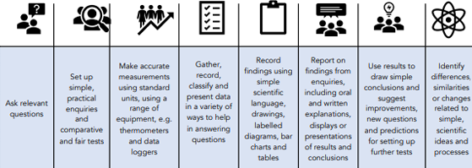
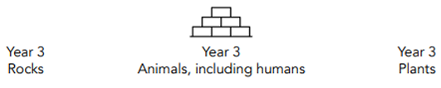
Key Stage 2 – Year 4
Term | NC objectives | The Big Idea Substantive Concepts | How will I think and act like a Scientist | Pupil Outcomes Scientific knowledge and understanding
Year 4 Autumn Term | recognise that living things can be grouped in a variety of ways explore and use classification keys to help group, identify and name a variety of living things in their local and wider environment recognise that environments can change and that this can sometimes pose dangers to living things. | Living Things and Their Habitats How can animals be grouped? |  | I know that vertebrates have a backbone and invertebrates do not I know that all living things: move, respire, are sensitive, grow, reproduce, excrete, need nutrition I know that vertebrates include the animal groups: fish, mammals, birds, amphibians; reptiles. Invertebrates include the animal groups: insects; annelids (worms); arachnids; molluscs.. I know that warm-blooded animals keep a consistent temperature no matter what the air temperature is I know that cold blooded animals change their body temperature to match their environment I know that flowering plants reproduce using flowers to make seeds. They will learn examples of plants are part of this group. I know that non-flowering plants reproduce using spores and seed cones. They will learn examples of plants are part of this group. I know that Carl Linnaeus invented the way we classify living things in 1737 I know that scientists use classification keys to identify, explain and sort living things I know that living things are divided into kingdoms: the animal kingdom, plants, fungi, bacteria, and single-celled organisms I know that a habitat is a natural place where an organism lives I know that environment is the conditions and surroundings which affect the survival and growth of living things I know that ecosystems are how living things interact with their habitat and environment I know that pollution is where harmful or poisonous things have a negative impact on the environment.
Curriculum Narrative and Previous Learning
N 3-4
Year
4
Year
1
Year
5
Key Stage 3

Slide 25

Key Stage 2 – Year 4
Term | NC objectives | The Big Idea Substantive Concepts | How will I think and act like a Scientist | Pupil Outcomes Scientific knowledge and understanding
Year 4 Autumn Term | compare and group materials together, according to whether they are solids, liquids or gases observe that some materials change state when they are heated or cooled, and measure or research the temperature at which this happens in degrees Celsius (°C) identify the part played by evaporation and condensation in the water cycle and associate the rate of evaporation with temperature. | States of Matter What are solids, liquids and gases? |  | I know that things are composed of a material in one of three states of matter: solid, liquid or gas I know that things are made of particles (tiny building blocks) and that these are organized differently in different states I know that materials can change state when temperature changes I know that there are bonds between the particles (building blocks) in a solid; as temperature increases, these bonds are somewhat overcome as the particles absorb energy and solids can change into liquids; with a further increase in temperature, the particles become even more energetic and the bonds are overcome entirely so the liquid changes into a gas I know that when solids turn into liquids, this is called melting and that the reverse process is called freezing I know that when liquids turn into gases, this is called evaporation and that the reverse process is called condensation I know that the freezing point of water is 0o C and that the boiling point of water is 100o C
Curriculum Narrative and Previous Learning
N 3-4
Year
4
Year
1
Year
5
Key Stage 3

Slide 26
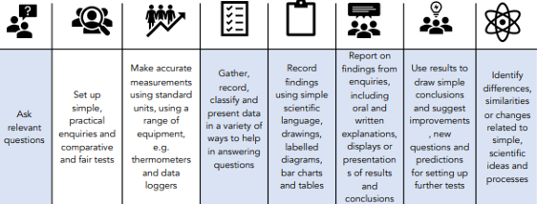

Key Stage 2 – Year 4
Term | NC objectives | The Big Idea Substantive Concepts | How will I think and act like a Scientist | Pupil Outcomes Scientific knowledge and understanding
Year 4 Spring Term | identify the different types of teeth in humans and their simple functions describe the simple functions of the basic parts of the digestive system in humans construct and interpret a variety of food chains, identifying producers, predators and prey. | Animals including Humans What are the parts of the digestive system and how does it work? What is a food chain? |  | I know that the process of digestion begins with food being chewed in the mouth by the teeth and saliva added I can identify the different types of teeth in humans and their simple functions I can describe the simple functions of the basic parts of the digestive system in humans I can construct and interpret a variety of food chains, identifying producers, predators and prey. I know that a human has four types of teeth (incisors, canines, pre-molars and molars) and that these each perform different functions I know that the mouth breaks up the food, saliva starts to digest the food and the tongue pushes the food I know that children develop an initial set of teeth (20) which are gradually replaced with adult teeth (32) I know that carnivores eat meat and have canines to tear and rip and a few molars to grind I know that the oesophagus is a muscular tube which pushes food down to the stomach The stomach has muscles which churn food with acids and enzymes; this turns the food into a liquidy mixture I know that the small intestine is where digestible food in absorbed I know that in the large intestine the colon removes water from the food and food that cannot be digested leaves the body via the rectum I know that defecation is when we pass waste from our bodies as faeces I know that a food chain shows the relationship between living things and is a path of energy I know that a predator hunts naturally and eats other living things I know that prey is an animal which is hunted, killed and eaten by another I know that a producer is a plant and this always starts the food chain. The plant makes its own food. I know consumers are animals who eat other animals and/or plants
Curriculum Narrative and Previous Learning
N 3-4
Year
4
Year
1
Year
5
Key Stage 3

Slide 27
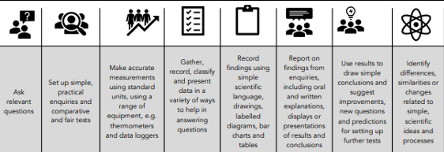
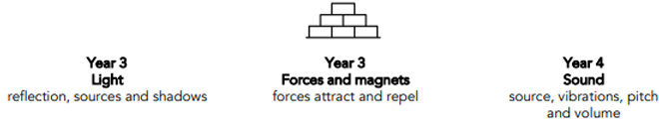
Key Stage 2 – Year 4
Term | NC objectives | The Big Idea Substantive Concepts | How will I think and act like a Scientist | Pupil Outcomes Scientific knowledge and understanding
Year 4 Summer Term | identify common appliances that run on electricity construct a simple series electrical circuit, identifying and naming its basic parts, including cells, wires, bulbs, switches and buzzers recognise that a switch opens and closes a circuit and associate this with whether a lamp lights in a simple series circuit recognise some common conductors and insulators, and associate metals with being good conductors. | Electricity What makes an electrical circuit? |  | I know that mains electricity is supplied to a building by wires I know that mains electricity powers things that are plugged into a socket using a plug I know that appliances that need mains electricity need more power than battery-operated objects I know that batteries are a portable source of stored energy I know that we must be safe with electricity I know that simple series circuits are made up of components I know that a switch can make a circuit open or close I know that if components are changed in a circuit, this will have an effect on the brightness of the bulb I know that materials that allow electricity to pass through are conductors and materials that block electricity are called insulators
Curriculum Narrative and Previous Learning
N 3-4
Year
4
Year
1
Year
5
Key Stage 3

Slide 28

Key Stage 2 – Year 4
Term | NC objectives | The Big Idea Substantive Concepts | How will I think and act like a Scientist | Pupil Outcomes Scientific knowledge and understanding
Year 4 Summer Term | Identify how sounds are made, associating some of them with something vibrating recognise that vibrations from sounds travel through a medium to the ear find patterns between the pitch of a sound and features of the object that produced it find patterns between the volume of a sound and the strength of the vibrations that produced it recognise that sounds get fainter as the distance from the sound source increases. | Sound What is sound? |  | I know that sound is a very quick vibration and travels in waves I know that sound can only travel through a medium such as solid, liquid or gas I know that sound travels through anything with particles I know that you can hear sound and cab see/feel the vibrations I know that sound is drawn as a sine wave I know that sound gets fainter as the sound energy spreads out while it travels I know that sound travels at 340 metres per second I know that pitch is how high or low a sound is and is measured in Hertz (Hz) I know that the size, length and tightness of the things vibrating will affect the pitch I know that volume is the loudness or quietness of a sound I know that two things that affect loudness are the amount of energy and the amount of matter vibrating
Curriculum Narrative and Previous Learning
N 3-4
Year
4
Year
1
Year
5
Key Stage 3

Slide 29
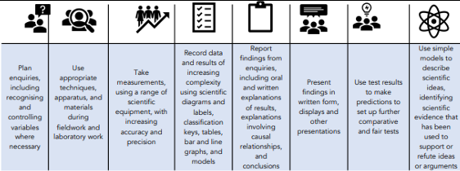

Key Stage 2 – Year 5
Term | NC objectives | The Big Idea Substantive Concepts | How will I think and act like a Scientist | Pupil Outcomes Scientific knowledge and understanding
Year 5 Autumn Term | compare and group together everyday materials based on their properties, including their hardness, solubility, transparency, conductivity (electrical and thermal), and response to magnets know that some materials will dissolve in liquid to form a solution use knowledge of solids, liquids and gases to decide how mixtures might be separated, including through filtering, sieving and evaporating give reasons, based on evidence from comparative and fair tests, for the particular uses of everyday materials, including metals, wood and plastic. | Properties and Changes of Materials Is this change reversible? |  | I know that materials are made from atoms and molecules; an atom is the smallest known part of any material; a molecule is two or more atoms joined by a bond; particles can be atoms and molecules. I know that materials can be magnetic; conductors (allow heat and electricity to travel through them); insulators (do not allow heat and electricity through); transparent (see through); opaque (can’t be seen through); translucent (can see through slightly); soluble (can be dissolved). I know that materials have properties that make them good insulators/conductors. I know that solutions are liquids that have a material dissolved in them; mixtures are two or more materials mixed together; solutes are the dissolved materials in a liquid; solvents are the liquid. I know that dissolving is when a solid, liquid or gas breaks down into tiny particles and mixes with the liquid, so they can’t be seen. I know that materials can be separated based on their properties (e.g. magnetic, soluble) through filtering, sieving and evaporation. I know that reversible changes are those where the original state of the materials can be returned to, such as physical changes (melting ice); irreversible changes cannot be undone, such as chemical changes (burning, cooking).
Curriculum Narrative and Previous Learning
N 3-4
Year
4
Year
1
Year
5
Key Stage 3

Slide 30
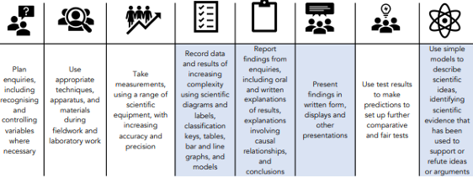
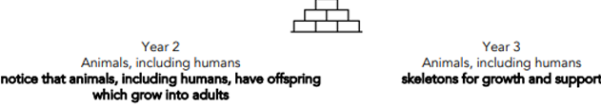
Key Stage 2 – Year 5
Term | NC objectives | The Big Idea Substantive Concepts | How will I think and act like a Scientist | Pupil Outcomes Scientific knowledge and understanding
Year 5 Autumn Term | Describe the changes as humans develop to old age. Pupils should draw a timeline to indicate stages in the growth and development of humans. They should learn about the changes experienced in puberty. Pupils could work scientifically by researching the gestation periods of other animals and comparing them with humans: by finding out and recording the length and mass of a baby as it grows. | Animals including Humans How do we change as we grow older? |  | I know that humans go through stages of development; they begin as fertilized eggs and then develop into embryos (0-7 weeks), before developing into a foetus (8/40 weeks); once they are born, these new-born babies become toddlers (1-3 years) then into young children (roughly 3-12 years old); children develop into adults during adolescence (roughly 13 - 19 years old) at which age they become physically capable of reproduction; as adults develop into old age (roughly 65+ years old) they experience changes in their body which require them to move more carefully and rest more frequently. I know that adolescence means young man/woman; males and females go through puberty (girls at roughly 11 years old, boys 12-13, but this can range from 8-14 years); girls develop breasts, pubic hair and underarm hair; boys develop pubic and underarm hair; both get spots as skin changes. I know that humans and animals have gestation periods; humans – 40 weeks, elephants – 95 weeks, however this doesn’t mean a longer life expectancy
Curriculum Narrative and Previous Learning
N 3-4
Year
4
Year
1
Year
5
Key Stage 3

Slide 31
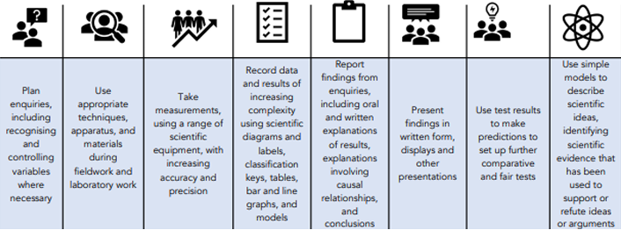
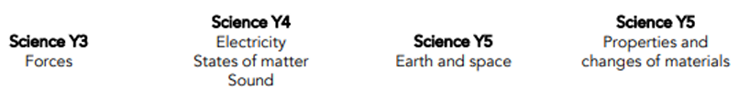
Key Stage 2 – Year 5
Term | NC objectives | The Big Idea Substantive Concepts | How will I think and act like a Scientist | Pupil Outcomes Scientific knowledge and understanding
Year 5 Spring Term | explain that unsupported objects fall towards the Earth because of the force of gravity acting between the Earth and the falling object identify the effects of air resistance, water resistance and friction, that act between moving surfaces | Forces How do forces affect the movement of objects? |  | I know that friction is a force that always opposes the direction of an object’s movement; it can be helpful in brakes, anti-slip surfaces, tyre tread; it can be unhelpful when bike chains stick making it harder to cycle. I know that air resistance is a type of friction that opposes the movement of an object through the air; it can be affected by the object’s surface area and speed. I know water resistance is a force that opposes an object’s movement through water; upthrust acts upwards on objects in water; the shape of the object changes the amount of water it displaces (larger surface area = more upthrust)..
Curriculum Narrative and Previous Learning
N 3-4
Year
4
Year
1
Year
5
Key Stage 3

Slide 32
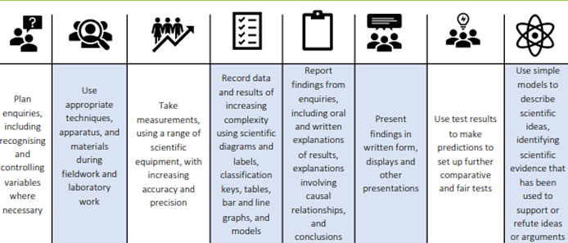
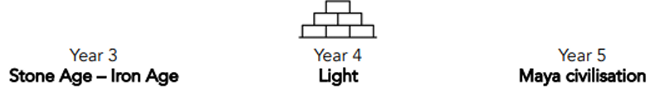
Key Stage 2 – Year 5
Term | NC objectives | The Big Idea Substantive Concepts | How will I think and act like a Scientist | Pupil Outcomes Scientific knowledge and understanding
Year 5 Spring Term | • describe the movement of the Earth, and other planets, relative to the Sun in the solar system • describe the movement of the Moon relative to the Earth • describe the Sun, Earth and Moon as approximately spherical bodies • use the idea of the Earth’s rotation to explain day and night and the apparent movement of the sun across the sky. | Earth and Space How is our solar system organised? |  | I know that there are eight major planets in our solar system: Mercury, Venus, Earth, Mars, Jupiter, Saturn, Uranus, Neptune I know that Mercury, Venus, Earth and Mars are rocky planets and Jupiter, Neptune, Saturn and Uranus are ‘gas giants’; Pluto is a dwarf planet. I know that all planets orbit the Sun and the further they are from the Sun, the longer the orbit; each one spins on an axis; planets are known as approximately spherical bodies; Earth’s orbit takes 365 ¼ days; Pluto takes around 250 years to orbit the Sun. I know that the moon doesn’t change shape, but our view of it changes as it orbits the Earth; its stages are: new moon, waxing crescent, first quarter, waxing gibbous, full moon, waning gibbous, third quarter and waning crescent; its orbit of Earth lasts 28 days. I know that the Earth turns one full rotation (anti clockwise) in 24 hours, resulting in night and day; sunrise is when our place on Earth begins to face the Sun; midday is facing the Sun directly at its highest point in the sky; sunset is when our place on Earth begins to turn away; night is when we are facing away from the Sun. I know that the tilt of the Earth leads to the seasons: tilted towards the Sun means the Sun is higher in sky (Spring and Summer); tilted away from the Sun means the Sun is lower in the sky (Autumn and Winter).
Curriculum Narrative and Previous Learning
N 3-4
Year
4
Year
1
Year
5
Key Stage 3

Slide 33
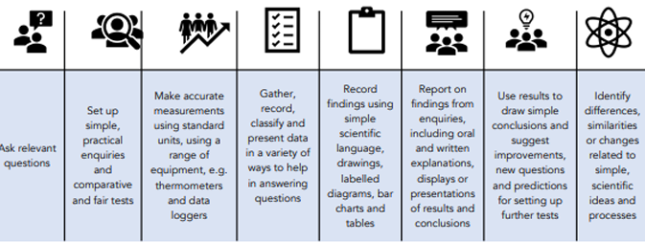
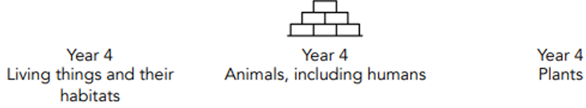
Key Stage 2 – Year 5
Term | NC objectives | The Big Idea Substantive Concepts | How will I think and act like a Scientist | Pupil Outcomes Scientific knowledge and understanding
Year 5 Summer Term | • describe the differences in the life cycles of a mammal, an amphibian, an insect and a bird • describe the life process of reproduction in some plants and animals. | Living Things and Their Habitats How do the life cycles of animals differ? |  | I know that generally, mammals are vertebrates; develop as an embryo, give birth to live young; reproduce through sexual reproduction; feed babies with the mother’s milk; grow larger when young; adolescents mature into adults. I know that amphibians are vertebrates; reproduce sexually; lay eggs, that contain embryos, in water; are once larvae that hatch with gills; physically change as they mature (called metamorphosis); grow legs, lungs and the young become adults. I know that insects are invertebrates; reproduce sexually; lay eggs that later hatch into larvae; the larvae then feed and grow, before transforming into a pupa - they undergo a biochemical change in which the larval body breaks down and reforms as an adult (metamorphosis). I know that birds are vertebrates; reproduce sexually; lay eggs that are kept warm in a nest; the embryo grows inside the fertilised egg; however, unfertilised eggs don’t produce chicks; chicks grow more feathers and mature into adults. I know that over 300 years ago, Maria Merion’s work around entomology (the study of insects) helped to change beliefs about how insects were formed; she made detailed notes and diagrams from her observations to do this; she is known as an important contributor to entomology. • reproduction means to make a copy and is necessary for survival sexual reproduction (most plants and animals) is between a male and female and combines their cells asexual reproduction is to make an identical copy of the parent flowering plants sexually reproduce through pollination (combining the male pollen and female ovule); seeds are produced that germinate and grow into a seedling. some plants reproduce asexually (make an identical copy)
Curriculum Narrative and Previous Learning
N 3-4
Year
4
Year
1
Year
5
Key Stage 3

Slide 34

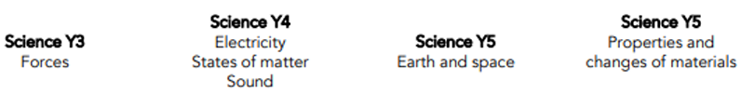
Key Stage 2 – Year 5
Term | NC objectives | The Big Idea Substantive Concepts | How will I think and act like a Scientist | Pupil Outcomes Scientific knowledge and understanding
Year 5 Summer Term | • recognise that some mechanisms, including levers, pulleys and gears, allow a smaller force to have a greater effect. | Forces How do forces help us? |  | I know that levers all have a load (the force applied); an arm or rod and a fulcrum, or pivot, that the arm moves around. I know that pulleys are mechanisms that help to move heavy things and have a grooved wheel, an axle and rope. I know that gears are rotating wheels with teeth that interlock to turn each other: there is always a driver gear and a follower gear; they use a small force to have a greater effect. I know that Galileo Galilei was an Italian astronomer and physicist who studied the science of motion; he improved the telescope; he discovered the weight of an object doesn’t affect how fast it falls; he studied the moons of Jupiter and their movement around Jupiter, supporting Copernicus’ theory of the heliocentric model.
Curriculum Narrative and Previous Learning
N 3-4
Year
4
Year
1
Year
5
Key Stage 3

Slide 35
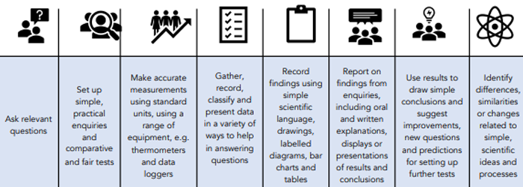
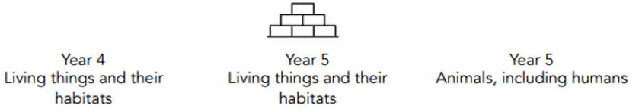
Key Stage 2 – Year 6
Term | NC objectives | The Big Idea Substantive Concepts | How will I think and act like a Scientist | Pupil Outcomes Scientific knowledge and understanding
Year 6 Autumn Term | • describe how living things are classified into broad groups according to common observable characteristics and based on similarities and differences, including microorganisms, plants and animals • give reasons for classifying plants and animals based on specific characteristics | Living Things and Their Habitats How can animals be classified? |  | I know that Carl Linnaeus was a Swedish naturalist who created the taxonomy systems to organise all living things; living things are organised by Kingdoms (Animals, Plants, Fungi, Bacteria, Algae), Phylum (Vertebrate, Mollusc, Arthropod), Class (mammals, reptiles, fish). I know that vertebrates are grouped into 5 classes: amphibians, birds, fish, mammals and reptiles. I know that invertebrates (approx.. 95% of animal species) are grouped into 7 classes: sponges, flatworms, jellyfish, arthropods (crustacean, arachnida, insects, myriapods), annelida, Echinodermata and molluscs I know that arthropod is an invertebrate with a hard , external skeleton and jointed limbs I know that insects are a type of arthropod; their bodies consist of six legs, a head, a thorax and an abdomen; most insects also have a pair of antennae and a pair of wings I know that an arachnid (e.g. spider) is a type of arthropod with eight legs and no antennae or wings I know that a crustacean is a type of arthropod with two pairs of antennae (e.g. woodlouse) I know that a myriapod is an arthropod with a flat and long or cylindrical body and many legs (e.g. centipede)
Curriculum Narrative and Previous Learning
N 3-4
Year
4
Year
1
Year
5
Key Stage 3

Slide 36
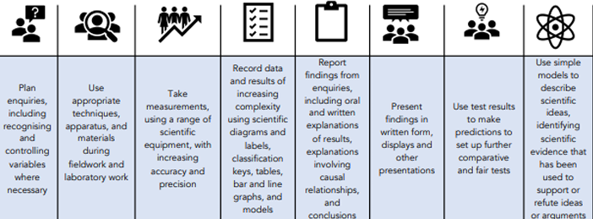
Key Stage 2 – Year 6
Term | NC objectives | The Big Idea Substantive Concepts | How will I think and act like a Scientist | Pupil Outcomes Scientific knowledge and understanding
Year 6 Autumn Term | • recognise that light appears to travel in straight lines •use the idea that light travels in straight lines to explain that objects are seen because they give out or reflect light into the eye • explain that we see things because light travels from light sources to our eyes or from light sources to objects and then to our eyes • use the idea that light travels in straight lines to explain why shadows have the same shape as the objects that cast them. | Light How does light travel? |  | I know that translucent objects allow some light to pass through, but some of the light changes direction as it passes through the object; this means that an something seen through a translucent object is not clearly defined I know that when light passes from one medium to another (e.g. from air to water), it changes direction; this is called refraction; this happens because light travels at different speeds in different media. I know that white light refracted by two surfaces in a prism will spread out so that all of its constituent colours can be seen; this array of colours is called a spectrum; it happens because the different colours of that constitute white light travel at different speeds. I know that how to draw a diagram to show why the shape of a shadow will match the shape of an object I know that when light reflects off an object, the angle of incidence is equal to the angle of reflection I know that a periscope takes advantage of the predictable angles of incidence and reflection to allow an image to be shown to a viewer
Curriculum Narrative and Previous Learning
N 3-4
Year
4
Year
1
Year
5
Key Stage 3

Slide 37
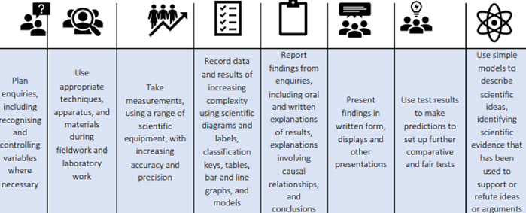
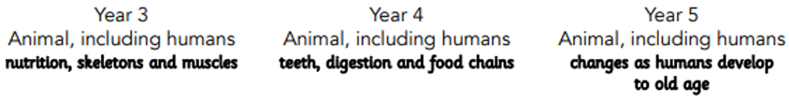
Key Stage 2 – Year 6
Term | NC objectives | The Big Idea Substantive Concepts | How will I think and act like a Scientist | Pupil Outcomes Scientific knowledge and understanding
Year 6 Spring Term | • identify and name the main parts of the human circulatory system, and describe the functions of the heart, blood vessels and blood • recognise the impact of diet, exercise, drugs and lifestyle on the way bodies function • describe the ways in which nutrients and water are transported within animals, including humans. | Animals including Humans What is the circulatory system and how does it work? |  | I know that blood carries nutrients (such as oxygen and water) around the body and helps to remove waste products from the body. I know that blood is made of red blood cells, plasma, platelets and white blood cells; be able to describe each component’s purpose and their relative proportions. I know that the main parts of the circulatory system are: heart, lungs, arteries, veins and capillaries; know the purpose of each part. I know that blood travels around the body (heart -> lungs -> heart -> body). I know that the heart beats to move oxygenated blood to the body and deoxygenated blood to the lungs. I know that arteries carry oxygenated blood away from the heart; veins carry deoxygenated blood to the heart; capillaries are blood vessels that connect arteries and veins. I know that the heart is composed of four chambers: two atria and two ventricles; the aorta is the largest artery I know that the right side of the heart receives deoxygenated blood from the body and sends it to the lungs; the left side receives oxygenated blood from the lungs. I know that the work of Galen and William Harvey influenced our knowledge and understanding of the circulatory system I know that they can lead a healthy life through exercise and the consumption of water and a healthy, balanced diet; know the effects of being healthy. I know that when we exercise, our heart beats more frequently so that the oxygen that is used can be replenished
Curriculum Narrative and Previous Learning
N 3-4
Year
4
Year
1
Year
5
Key Stage 3

Slide 38
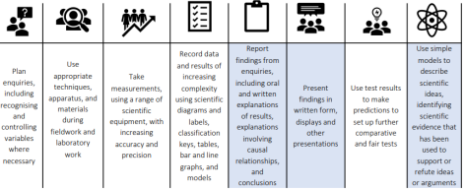
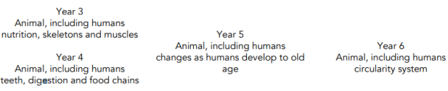
Key Stage 2 – Year 6
Term | NC objectives | The Big Idea Substantive Concepts | How will I think and act like a Scientist | Pupil Outcomes Scientific knowledge and understanding
Year 6 Spring Term | Describe the ways in which nutrients and water are transported within animals, including humans. | Animals including Humans How do our kidneys keep us healthy? |  | I know that the digestive system includes the mouth, teeth, tongue, oesophagus, stomach, intestines and the rectum; helps us to break down nutrients and water and absorb them into the bloodstream. I know that the circulatory system includes the heart, arteries, veins, capillaries, lungs and blood; blood moves important nutrients and waste products around the body. I know that the kidneys are found either side of the vertebrae; blood enters the kidneys and waste products (toxins) are filtered out, cleaning the blood (around 180 litres a day); waste products are dissolved in water, creating urine; kidneys adjust the amount of water they excrete due to the body’s water levels (urinate less when dehydrated). I know that darker urine means you are dehydrated (not enough water to function optimally); signs of dehydration are headaches, thirst, dry mouth.
Curriculum Narrative and Previous Learning
N 3-4
Year
4
Year
1
Year
5
Key Stage 3

Slide 39
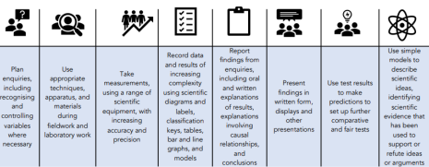
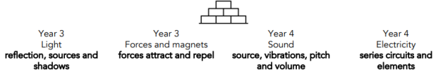
Key Stage 2 – Year 6
Term | NC objectives | The Big Idea Substantive Concepts | How will I think and act like a Scientist | Pupil Outcomes Scientific knowledge and understanding
Year 6 Spring Term | • associate the brightness of a lamp or the volume of a buzzer with the number and voltage of cells used in the circuit • compare and give reasons for variations in how components function, including the brightness of bulbs, the loudness of buzzers and the on/off position of switches • use recognised symbols when representing a simple circuit in a diagram. | Electricity How do the number of electrical components in a circuit affect how it works? |  | I know that atoms are the smallest part of matter and are made of protons and neutrons and electrons; protons are positively charged; neutrons are negatively charged. I know that voltage is the push given to move electrons around a circuit; the size of a battery doesn’t affect the power it has. I know that current is the flow of electricity measured in amps. I know that electricity travels in one direction, leaving the battery from the positive side and returning through the negative; electrical charge is made by generating electrons. I know that simple series circuits are simple loops with a battery and other components; the number of cells affects the brightness of a bulb. I know that each part of a circuit has a symbol; switches can be shown as closed or open in a circuit diagram. I know that as the number and voltage of cells in a circuit increases, the brightness of a bulb or the volume of a buzzer will increase. I know that they can predict whether components will function depending on whether the circuit is complete; whether a switch is in an on or off position; and whether there is a cell to provide electrical current to the circuit. I know that two bulbs in a circuit can be wired up to create a series circuit or a parallel circuit; if one bulb blows in a series circuit the other will not shine as the circuit has been broken I know that it is dangerous to play with plugs/leave liquid near electrical items/touch exposed wires/touch switches with wet hands/fly kites near overhead power lines.
Curriculum Narrative and Previous Learning
N 3-4
Year
4
Year
1
Year
5
Key Stage 3

Slide 40
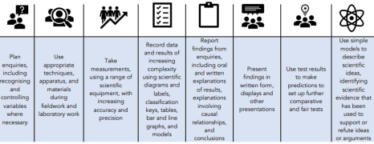
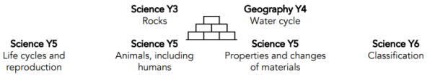
Key Stage 2 – Year 6
Term | NC objectives | The Big Idea Substantive Concepts | How will I think and act like a Scientist | Pupil Outcomes Scientific knowledge and understanding
Year 6 Summer Term | • recognise that living things have changed over time and that fossils provide information about living things that inhabited the Earth millions of years ago • recognise that living things produce offspring of the same kind, but normally offspring vary and are not identical to their parents • identify how animals and plants are adapted to suit their environment in different ways and that adaptation may lead to evolution. | Evolution and Inheritance How has life evolved? |  | I know that fossils are the remains of living things that died a long time ago; the fossil record can show how living things have changed over time; some fossil records have gaps as they haven’t all been found, or due to decomposition. I know that there are different types of fossil: body, mould, cast and trace and identify them. I know that living things have evolved over time and this gradual change is called evolution. I know that DNA is a molecule in a cell that carries genes, which hold genetic information; genes determine inheritable characteristics such as eye and hair colour; acquired characteristics are as a result of environmental impacts, not DNA. I know that living things reproduce in different ways to produce offspring (sexual/asexual); offspring are not identical in sexual reproduction (variation). I know that Charles Darwin posited the theory of evolution by natural selection; Alfred Wallace found a similar conclusion and supported Darwin’s theory. I know that natural selection is due to living things having desirable characteristics, that favour survival, being passed on to offspring. I know that living things have evolved to develop adaptive traits that are advantages or disadvantages; ‘survival of the fittest’ is when living things survive due to their useful inherited characteristics which are passed to their offspring;
Curriculum Narrative and Previous Learning
N 3-4
Year
4
Year
1
Year
5
Key Stage 3

